Slide 1
Business Income
Form 1040: Line 12
Pub 4012: Pages D – 12 to D – 14
Pub 4491: Part 3 – Lesson 10
Notes:
1
WEAKNESS ALERT Some counselors complete Schedule Cs that are out-of-scope
Direct the students to D-10 in the 4012 to review the rules for our In-Scope treatment of self-employed business income
Changes:
#9 Line 29 is for health insurance only; all other medical goes on Sch A
#10 clarified de minimis is in scope
#19 updated speaker notes re household employee limit of $2,000
#27 - #39 substantially updated
#51 Cell phone subject to proration – not a landline

Slide 2

Is it a Business?
There are 3 choices
A business
Income producing, but not a business
Not entered into for profit (e.g. hobby)

Slide 3
A Business
Facts and circumstances:
  Profit motive
  Reasonable expectation of profit
  Means of livelihood
  Regular activity
  Conducted in a business-like manner
Notes:
One-time payments may or may not be a business
Sporadic activity may not be a business – but once a year, every year might be a business
Income cannot be on a W-2 – except statutory employees

Slide 4
Income Producing, Not a Business
Facts and circumstances:
  Sporadic activity, e.g., one-time fee
  Gambling winnings
  Investing
  Sale of personal assets (e.g. yard sales, Craig’s list, etc.)
Notes:
One-time payments may or may not be a business
Sporadic activity may not be a business – but once a year, every year might be a business

Slide 5
Not Entered Into for Profit
Facts and circumstances:
  Model airplane contest
  Beer mug collecting
  Antique hunting, when not a business
Usually, more pleasure driven than income driven
Not-for-profit activities are out of scope
Notes:
If this is an issue for your district here are the business vs. hobby criteria:
1. The manner that a taxpayer carries on an activity.
2. The expertise of a taxpayer or advisor(s) involved in the business activity.
3. The time and effort a taxpayer allocates to the activity.
4. Has the taxpayer had success with similar or dissimilar activities in the past?
5. The history of income/loss for the activity.
6. Are there occasional profits and, if so, how much are they?
7. The financial status of the taxpayer, and does the taxpayer rely on this business activity or does the taxpayer have other sources of income?
8. Is there an expectation of asset appreciation for any assets involved in the business activity?
9. Are there elements of personal pleasure or recreation?

Slide 6
The Interview
A conversation
Notes:
Encourage counselors to ask probing questions
It is not “prying,” it is essential to an accurate return

Slide 7
The Interview – A Conversation
Prior year return
Nature of business
Where is business conducted
Net profit or loss
Assets used in business
Record of income and expenses
Notes:
Steps and questions to determine whether in scope, before touching the computer
Ask participants why is the step performed or the question asked
Prior year’s return – a loss? too many expenses? Employees? 1099 payments to others?
Nature – is it really a business? Is there inventory?
Where – no office in the home
Loss this year?
Assets that can be depreciated or are eligible for immediate write-off require Form 4562 – out of scope
No records – need to determine whether business is legitimate and whether return can be prepared
Review how good records help taxpayers:
Monitor the progress of their business
Prepare their financial statements
Identify source of receipts
Keep track of deductible expenses
Prepare tax returns
Support items reported on tax returns
Ask: What are examples of business-related supporting documents?
Answers include: Sales slips, paid bills, invoices, receipts, deposit slips, canceled checks

Slide 8
Interview – Limitations On Scope
No net loss
Business expenses of $25,000 or less per Schedule C
Can have more than one Sch C if more than one business
  Do not combine businesses – If more than one business, need more than one Sch C

Slide 9
Interview – Limitations On Scope
Only sole proprietor
  No employees/no 1099 payments
Self-employed health insurance adjustment (1040 Line 29) is out of scope
No SEP/SIMPLE contribution

Slide 10
Interview – Limitations On Scope
No depreciation, amortization, or asset write-off that requires Form 4562
De minimis rule is in scope – can expense on Sch C assets up to $2,500 each (Form 4562 not needed)
More on this later
Notes:
An “asset” is any item whose life expectancy is more than one year
There is a limited write-off of business assets, but it requires for 4562 to be filed
Stress: it is important to identify whether there are business assets to properly assess whether the return is in scope

Slide 11
Interview – Limitations On Scope
No deduction for business use of home, such as:
  Rent
  Utilities
  Homeowner/renter insurance
  Not even the simplified method!
Notes:
IRS new simplified method
Still requires regular and exclusive use of the office in the home
Can be far less than the regular method would yield
Taxpayers with a home office that they believe can be deducted would be well served to see a paid preparer

Slide 12
Interview – Limitations On Scope
Cash method of accounting only
Must materially participate in business
Not a bartering business
  Exchange of services or property
  Value received is income!
No prior year unallowed passive activity loss
Notes:
Additional information that may be of interest:
Cash method as opposed to accrual method
All our Taxpayers normally satisfy the cash method requirement
All our Taxpayers normally participate in a material way in their business
Bartering – exchanging goods or services for other goods or services – OOS
If a Taxpayer says they have received goods or services, refer them to a paid preparer
The value of what they received must be included in income
Returns with a business loss have always been out of scope
If a new Taxpayer comes with a loss carryover, refer to a paid preparer

Slide 13
Interview – Limitations On Scope
No inventory (resale business)
  Goods purchased for resale
  Goods produced for resale
  Even if bought for immediate resale or a particular job, it is still inventory
Line 4, Cost of Goods Sold – out of scope
Notes:
Additional information that may be of interest:
Virtually every type of resale business requires inventory -- OOS
Even though it may be small, it is still inventory

Slide 14
Inventory Quiz
Is this inventory?
Furnishings bought by an interior designer for a specific client?
Fabric bought by an interior designer who will sew drapes for a client?
YES – designer is selling the furnishings to the client
Note: Answer could be NO if client buys the furnishings and designer charges a finding fee
YES – goods produced for resale are inventory

Slide 15
Interview – Business Income
Due diligence
  Does the taxpayer’s business sound reasonable
  If you have valid concerns that are not satisfied,
    You can decline to prepare return
    Speak privately with your Local Coordinator first if that’s what you decide
Notes:
Emphasize
Fraudsters will make up a business with no expenses just to get the EIC
Generally, all business expenses should be claimed
Particularly if it affects another benefit, such as EIC
Watch for examples of incorrect, incomplete, or inconsistent information, such as:
• Schedule C income in round numbers
• Schedule C cash businesses as the only income on a return claiming EIC
• Schedule C with little or no expenses when expenses would be expected
• Schedule C taxpayers with little or no records for income and expenses
• Any Schedule C income that brings the taxpayer to the maximum EIC
• Schedule C without a Form 1099

Slide 16
What if it is NOT a Business*
Income goes to Form 1040 line 21 (Income, Other Income, Less Common Income, Other Income Not Reported Elsewhere)
Deductible items go on Schedule A
  Usually subject to 2% of AGI (Lines 21 – 23)
    To produce or collect income or
    To manage or maintain income-producing property or
    To determine any tax
* Activities not entered into for profit are out of scope
Notes:
Not-a-business – examples
unexpected pay for coaching a team
contest winnings
once-a-year poll worker
Taxpayer may deduct expenses paid that relate to the income – examples
Team uniform for coaching
Mileage
Travel
Tax or legal consulting fees relating to the income
Does not include “hobbies” that are not entered into for profit

Slide 17
What if it is NOT a Business*
In some cases, deductible items go on Schedule A, but are not subject to 2% of AGI rule (Line 28)
  Gambling losses and expenses
  Certain other activities (see Deductions Lesson)
* Activities not entered into for profit are out of scope
Notes:
Gambling could be a business for a professional gambler – Sch C
For most, it is not a business
Gambling net winnings determined on a “session” basis are reported on 1040 L 21,
Gambling losses are deductible on Sch A, line 28
Expenses directly related to gambling are also deductible on line 28
If an expense has “personal” aspects, it should not be deducted

Slide 18
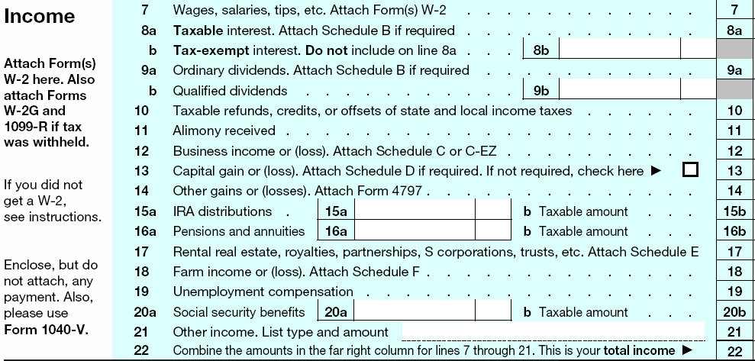
If it is a Business – Line 12
Notes:
Business profits will go to Line 12 of the 1040
In the 1040 View, click on line 12 to access documents completed for Sch. C.

Slide 19

Schedule C Quiz
Is this a business?
Income from recycling (conducted regularly)
Poll worker
Babysitter
One-time executor fee
Caregiver
  Who is a relative
  Who is not a relative
Yes
No
Yes, if not a household employee
No, unless in the business
No, unless in the business
Yes, if not a household
employee
Notes:
Answers:
Recycling: yes
Poll worker: no
Babysitter: yes
One-time executor: no, if not in business of being an executor (e.g. for a deceased family member or friend)
Related caregiver: only if taxpayer is in the business of caregiving; otherwise no
Unrelated caregiver: yes
Caregivers that are properly considered household employees may report their income as wages on 1040 L 7 IF the total received from that service recipient is less than $2,000 for the year
If there are multiple service recipients and each is less than $2,000, they may all be reported as wages
Use Notes feature to add up multiple recipients
If the amount received from any one recipient, the Taxpayer has a choice of reporting on Sch C as a business or using Form 8919 to “turn in” their employer
Form 8919 is out of scope

Slide 20
Schedule C Input
Use Schedule C
(do not use Schedule C-EZ)
Must be for either Taxpayer or Spouse
  Jointly run business must be split into two Schedules C
  Self-employment tax implications
Notes:
Community property laws are disregarded for self-employment tax purposes
If jointly run business, Taxpayer needs to specify the split ratio

Slide 21
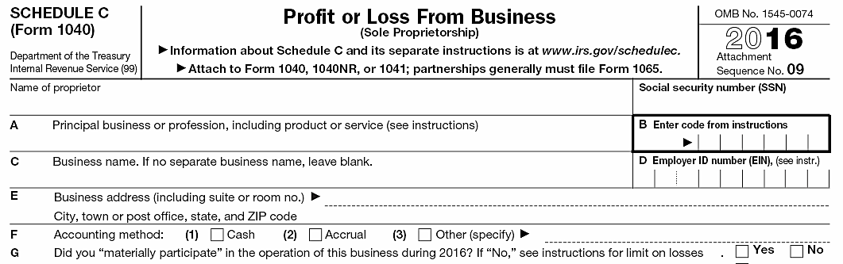
Schedule C
Schedule C as shown in printed return
Notes:
The actual tax form

Slide 22
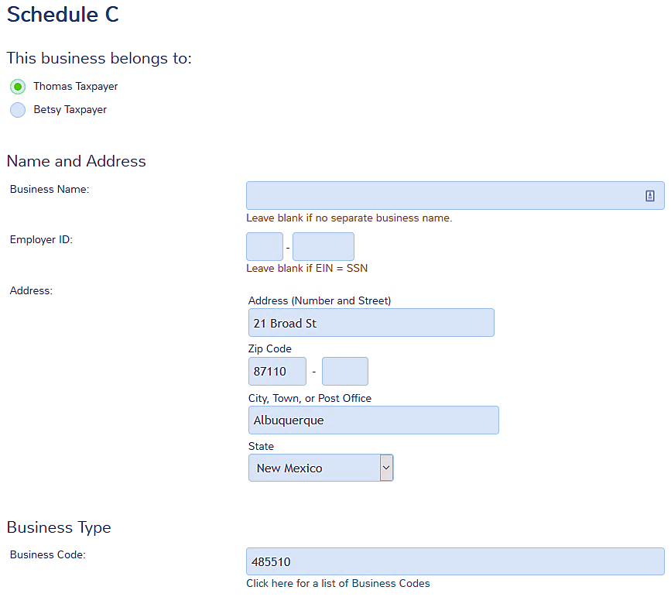
Schedule C Input
Choose taxpayer or spouse
Choose Business Code – fills in Description

Slide 23
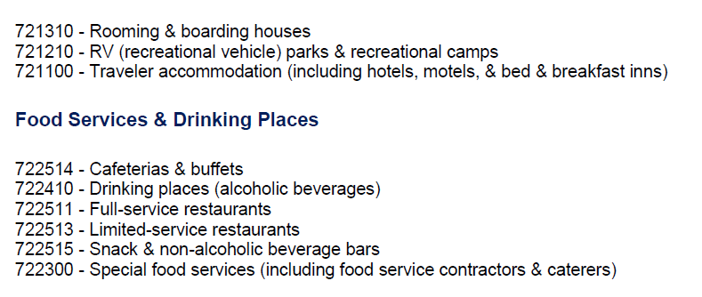
Business Code
Select code from the list
Or use cotaxaide.org/tools to look up the code
Notes:
Graphic designer:
Category: Professional, Scientific, & Technical Services
Code: Graphic designer: 541400

Slide 24
Business Code – Practice
Using TaxSlayer help, what is the business code for:
  Janitorial Services
  Independent …..
  Artist….Performer
  Educational Services
  Painting and Wall
  Covering Contractors
561720
711510
611000
238320
Notes:
Ask to look up codes or if running TS, demonstrate in program

Slide 25
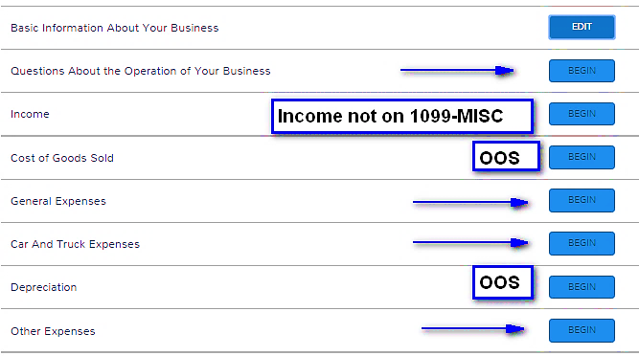
More Entries for Schedule C

Slide 26
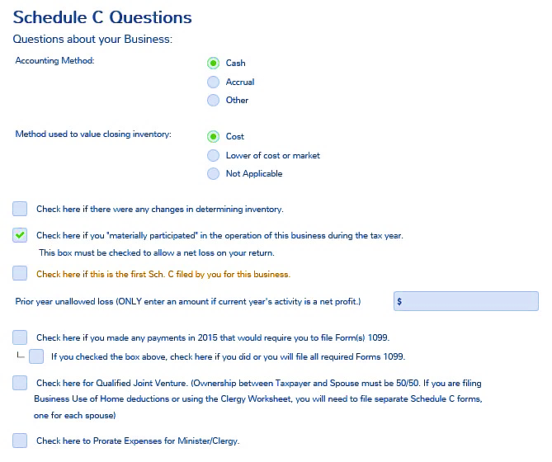
Schedule C Questions

Slide 27
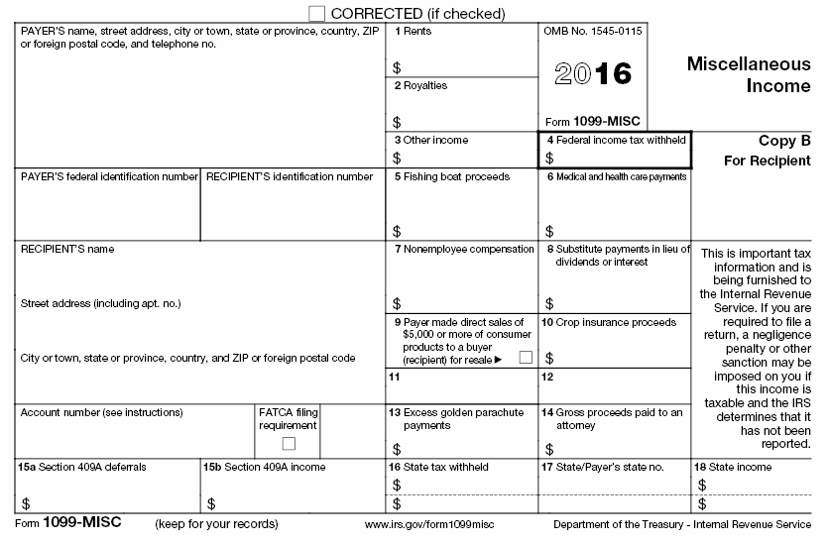
Business Income – 1099-MISC
Not Sch C
Can be Sch C
OOS
OOS
OOS
OOS
OOS
OOS
OOS
OOS
OOS
OOS
OOS
OOS
OOS
Notes:
Emphasize
Box 2 royalties if from taxpayer’s own services would go on Sch C, e.g. author or songwriter
Use of box 3 or box 7 varies by payer – taxpayer decides whether or not there is a business
Box 9 – if checked means that the Taxpayer has a resale business and is out of scope
Box 6 in some states is used to report caregiver compensation paid by the state or municipality

Slide 28
Business Income – 1099-MISC
Reported to Taxpayer on Form 1099-MISC
  Box 7: Non-employee compensation
  Box 3: Other income (?)
    Ask what income was for - payer may have used wrong box
Notes:
Consider the business.
Is it likely that the Taxpayer would have cash income?
If so, ask about it.3
All Income must be reported.
All Form 1099-MISCs must be input into TaxSlayer as a 1099-MISC (not summarized to “other income”)

Slide 29
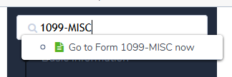
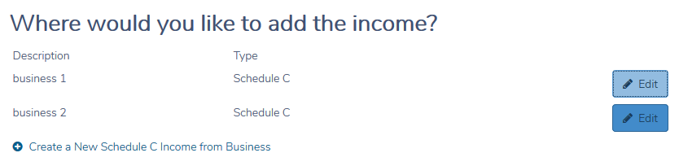
1099-MISC in TaxSlayer
Search 1099-MISC
Enter data from 1099-MISC
Add to an existing business or create a new one
Notes:
Emphasize
Use of box 3 or box 7 varies by payer – taxpayer decides whether or not there is a business
Box 9 – if checked means that the Taxpayer has a resale business and is out of scope
Box 6 in some states is used to report caregiver compensation paid by the state or municipality

Slide 30
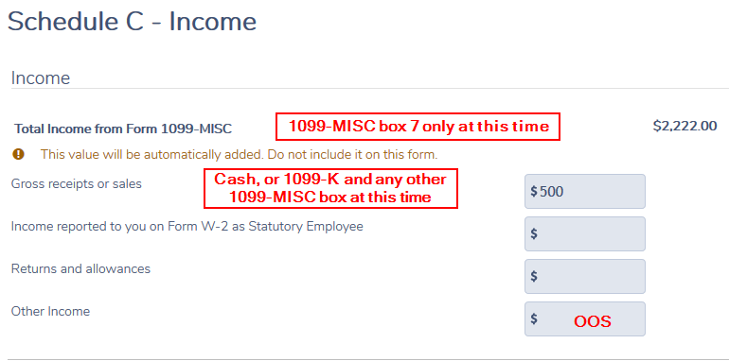
Business Income – Schedule C Income

Slide 31
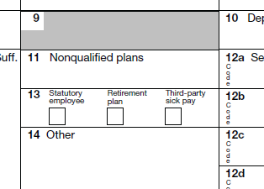
Statutory Employee (rare)
Statutory employee on Form W-2
Taxpayer wants to claim related expenses – use Sch C
  Input on Sch C
  Regular Sch C rules apply for expenses
Notes:
What!?!?! Business income on a W-2??? Special situation.
Statutory employees are a mixed situation
Reported on W-2 instead of 1099
Some taxes are withheld
Can take business expenses on Sch C, instead of Sch A

Slide 32
Statutory Employee
Statutory Employees include:
  Certain agents or commission drivers
  Full-time life insurance salespersons
  Certain homeworkers
  Traveling salespersons
Some employers may check the box in error
Notes:
If it doesn’t sound right, report on W-2 form and/or suggest Taxpayer gets a corrected W-2
“Employer” will withhold social security and Medicare taxes from statutory employee, maybe federal tax
No self-employment tax!
An explanation from IRS.gov of these workers:
A driver who distributes beverages (other than milk) or meat, vegetable, fruit, or bakery products; or who picks up and delivers laundry or dry cleaning, if the driver is your agent or is paid on commission.
A full-time life insurance sales agent whose principal business activity is selling life insurance or annuity contracts, or both, primarily for one life insurance company.
An individual who works at home on materials or goods that you supply and that must be returned to you or to a person you name, if you also furnish specifications for the work to be done.
A full-time traveling or city salesperson who works on your behalf and turns in orders to you from wholesalers, retailers, contractors, or operators of hotels, restaurants, or other similar establishments. The goods sold must be merchandise for resale or supplies for use in the buyer’s business operation. The work performed for you must be the salesperson's principal business activity.

Slide 33
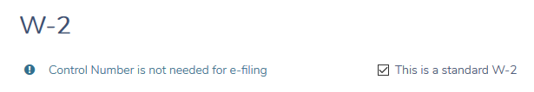
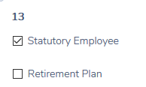
Statutory Employee in TaxSlayer
Enter W-2
Check box 13

Slide 34
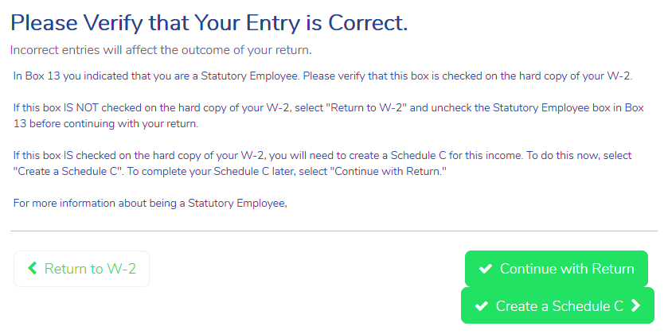
Statutory Employee
TaxSlayer wants you to confirm

Slide 35
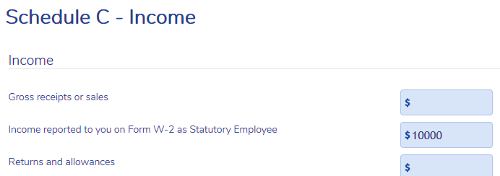
Statutory Employee in TaxSlayer
Need to enter “wage” amount again in Sch C

Slide 36
Business Income Quiz
What types of income should you expect to see for:
A wedding singer
  Checks and cash (gratuities!)
A graphic designer
  1099-MISC if > $600
  Checks or cash for small jobs
Notes:
Encourage audience participation
Emphasize to use common sense
Instead of asking “did you receive any tips”, maybe ask “how much in tips did you receive” (This question is NOT a yes/no question. It requires thought.)

Slide 37
Business Expenses
Ordinary and necessary to the business
Not against public policy
  Cannot deduct fines or penalties
All allowable and documented expenses need to be claimed
Note: not claiming an expense may result in a tax benefit that would not otherwise occur, e.g., it may improve EIC
Notes:
Review how good records help taxpayers: Refer to 4012 F-13
Monitor the progress of their business
Prepare their financial statements
Identify source of receipts
Keep track of deductible expenses
Prepare tax returns
Support items reported on tax returns
Ask: What are examples of business-related supporting documents?
Answer: Sales slips, paid bills, invoices, receipts, deposit slips, canceled checks.

Slide 38
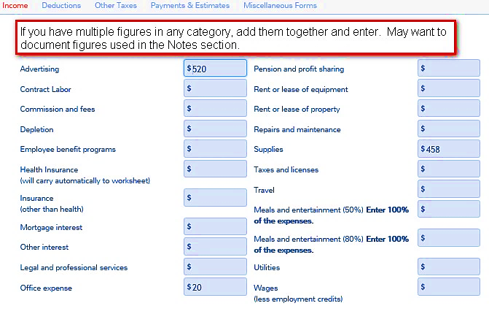
Business Expenses
Not Home Office
Notes:
Can use lines 8-25 or use page 2 of input form – shown later

Slide 39
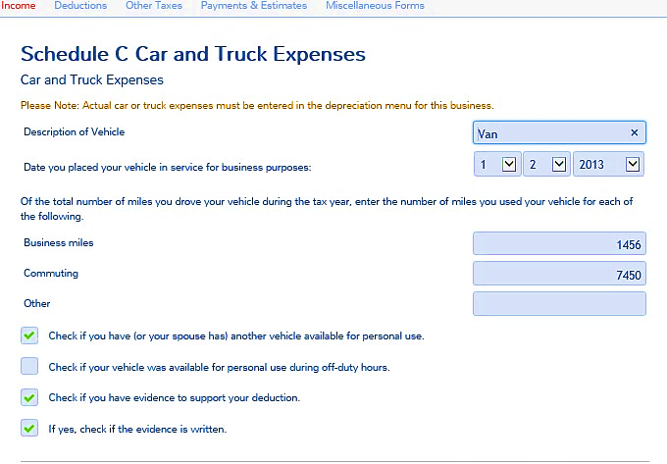
Business –Car and Truck Expenses
Notes:
Written records are required
Can be a log
Can be appointment book
Can be electronic
Should be contemporaneous (at or near time business miles are driven)

Slide 40
Business Expense Quiz
Are these items deductible? In scope?
Commissions and fees paid
Contract labor payments
Legal and professional services
Only if less than $600 per payee
More than $600 requires 1099 to be issued (OOS)

Slide 41
Business Expense Quiz
Are these items deductible? In scope?
Employee benefit programs
Pension and profit sharing
Wages
Out of scope – all relate to employees

Slide 42
Business Mileage
Actual expense method – out-of-scope
  OR
Standard mileage rate method
Notes:
Actual Expense Method:
The taxpayer determines the business portion of expenses for fuel, auto maintenance, parking fees and tolls, and auto loan interest
The actual expense method is out of scope.
Actual expense requires depreciation of vehicle – even if not claimed and is therefore out of scope
Standard Mileage Method: the taxpayer multiplies the business miles by the mileage rate for that tax year.

Slide 43

Business Mileage
Standard mileage rate includes:
Car depreciation
Gasoline, oil, etc.
Repairs and maintenance
Insurance
Car registration (non-tax portion)
Standard mileage rate does not include:
Parking
Tolls
Car registration (business part of property tax portion)
Notes:
Add to expenses on page 2:
parking
tolls
business part of the property tax portion of the car registration (if significant or if not itemizing deductions)
Mileage method applies to use of own car
Does not apply to rented car, bus, train, taxi, etc.
Can deduct rented car, bus, train, taxi, etc. in addition to standard mileage rate deduction
Caution: long term car rental (>30 days) are out of scope (special limitation rules apply)

Slide 44
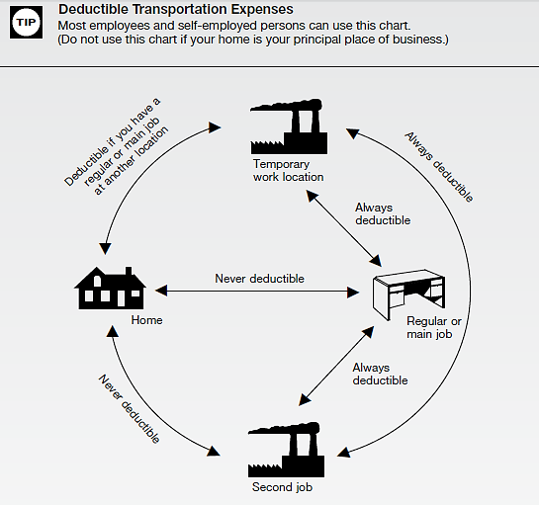
Business Mileage
Must understand
commuting versus
deductible travel
miles
  First and Last trip of
  the day are commuting miles
  and cannot be deducted
  Travel in between 1st and
  last trip are deductible
See Pub 4012 Tab F

Slide 45
Business Mileage
IRS position is that first mileage from home and last mileage back home is commuting (not deductible)
For a self-employed person, can claim first/last mileage if there is a deductible home office (out of scope)
If taxpayer might have an office in the home so that their mileage could be deducted, refer to a paid preparer

Slide 46
Business Mileage Quiz
Taxpayer claims business mileage and keeps records
Taxpayer has car accident while on business
Is insurance “deductible” deductible?
No – insurance (or the cost of self-insuring) is included in standard mileage rate

Slide 47
Business Mileage Quiz
Taxpayer claims business mileage and keeps records
Taxpayer pays valet to park car to attend a business meeting
Is valet fee deductible?
Yes, parking and tolls are deductible in addition to standard mileage rate

Slide 48
Business Expense – Outside Office
Rent
Office expenses (postage, supplies, etc.)
Insurance
Taxes
Business telephone and utilities
Not home office
Notes:
Cannot claim depreciation on the outside office!
Cannot write-off any assets
An item with a useful life of more than one year is an asset

Slide 49

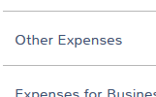
De minimis election
De minimis rule – can expense on Sch C assets up to $2,500 each (Form 4562 not needed)
Describe as “De minimis election under regs” and the amount being expensed

Slide 50
Business Expense – Computer
Requires written evidence of business use (listed property)
If requires depreciation or write-off using Form 4562 (more than $2,500), then out of scope
May claim supplies (paper, toner) used for business
Notes:
Asset write-off (either immediate or through depreciation) is out of scope
Computer and peripherals are also “listed property” which require
documented business use in order to claim depreciation or write-off
Supplies used for business are not assets – if they are used for business,
they are deductible

Slide 51
Business Expenses – Telephone
Business telephone – dedicated phone used only for business – 100% deductible
Mixed-use landline phone
  Basic service not deductible
  Actual cost of business calls deductible
Mixed-use cell phone
  Prorate cost based on business use
Notes:
Sanity check: is it reasonable?
100% business cell phone when Taxpayer has only one phone?
100% business internet fee? No personal use?
Business records are very important – although we do not need to see them

Slide 52

Meals and Entertainment
Special documentation rules apply if over $75.00
  Must have receipt (showing where, when and how much)
  Must document business nature of meal or entertainment
Notes:
Emphasize
Advise taxpayers of recordkeeping requirements

Slide 53
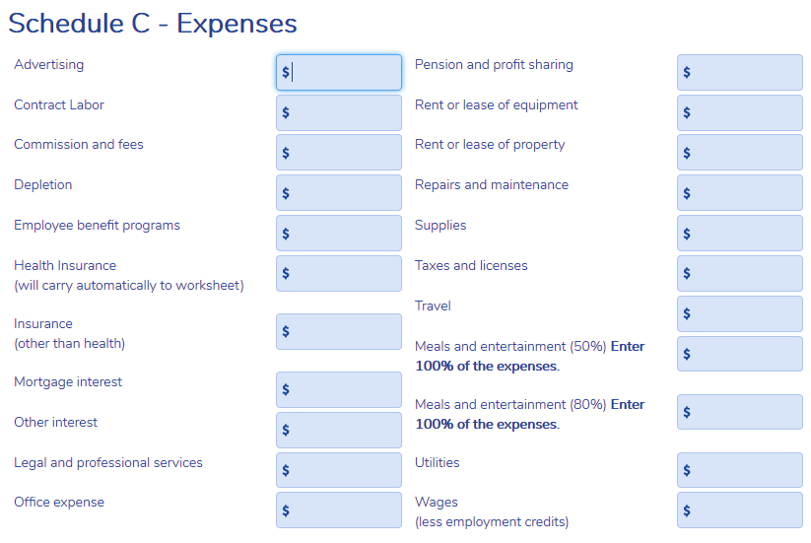
Business Expense – Meals and Entertainment
Enter 100% - TaxSlayer will apply 50% limitation
Notes:
For taxpayers we see, use the 50% line.

Slide 54
Business Gifts
Limited to $25 per recipient per year
Does not include “logo’d” articles of $4 or less each (e.g., a pen with a logo on it)
Notes:
Refer to recordkeeping guide on 4012 F-13

Slide 55
Health Insurance
Health insurance for taxpayer, spouse and dependents is not a Schedule C expense
Form 1040 Line 29 adjustment (out of scope) or itemized deduction on Schedule A
Line 29 adjustment is ~net cost of premiums capped at net profit from business
May be to taxpayer’s advantage to use paid preparer if potential Line 29 adjustment is “significant”

Slide 56
Business Income
TaxSlayer will automatically flow business net profit to other parts of return:
  Self-employment tax, except statutory employee
  Traditional IRA – use caution re Roth
  Earned income credit

Slide 57
Business Income
Quality Review
Is this really a business?
Do all 1099-MISC in TaxSlayer agree with originals – EIN, payer name, address, etc.?
Does Sch C net profit agree with taxpayer’s records?
How does net profit compare to prior year – is it reasonable?

Slide 58
Business Income Quality Review
Have all business expenses been included?
  Does taxpayer have education expenses that could (should) be deducted on Sch C
How does the state return look?

Slide 59


Business Income
Taxpayer Summary
Emphasize need to keep good records
  Can be paper or electronic
  Assures all income is accounted for
  Assures no expenses are forgotten
  Greatly facilitates tax return preparation

Slide 60
Business Income
Questions?
Comments…
Notes:
60

